Slide 1

ONLINE VOTING SYSTEM DATABASE
PRESENTATION BY
MANASI MURARKA - J038
KHYAATI NAYAK - J044
BHARATI PANIGRAHI - J045

Slide 2
Why this case study?
Since US elections are right around the corner and Corona virus is still spreading all across the world.
Assuming that India had its elections this year during the pandemic, going to a Voting centre would be impractical.
Because of India’s high population density maintaining social distancing and other precautionary measures during voting would be difficult.
To overcome this issue we wanted to come up with an alternative online voting system for elections in India.

Slide 3
Benefits of online voting system
The online voting system – India shall reduce the time spend making long queues at the voting centres.
It shall also enable the voters to vote from any part of the globe since this is an online application available on the internet.
Cases of vote miscounts shall also be solved since at the backend of this system resides a well developed database using MYSQL that can provide the correct data once it’s correctly queried.
Since the voting process shall be online, the voters can vote at anytime on that day and there won’t be a need for declaring the day of the election as a holiday

Slide 4
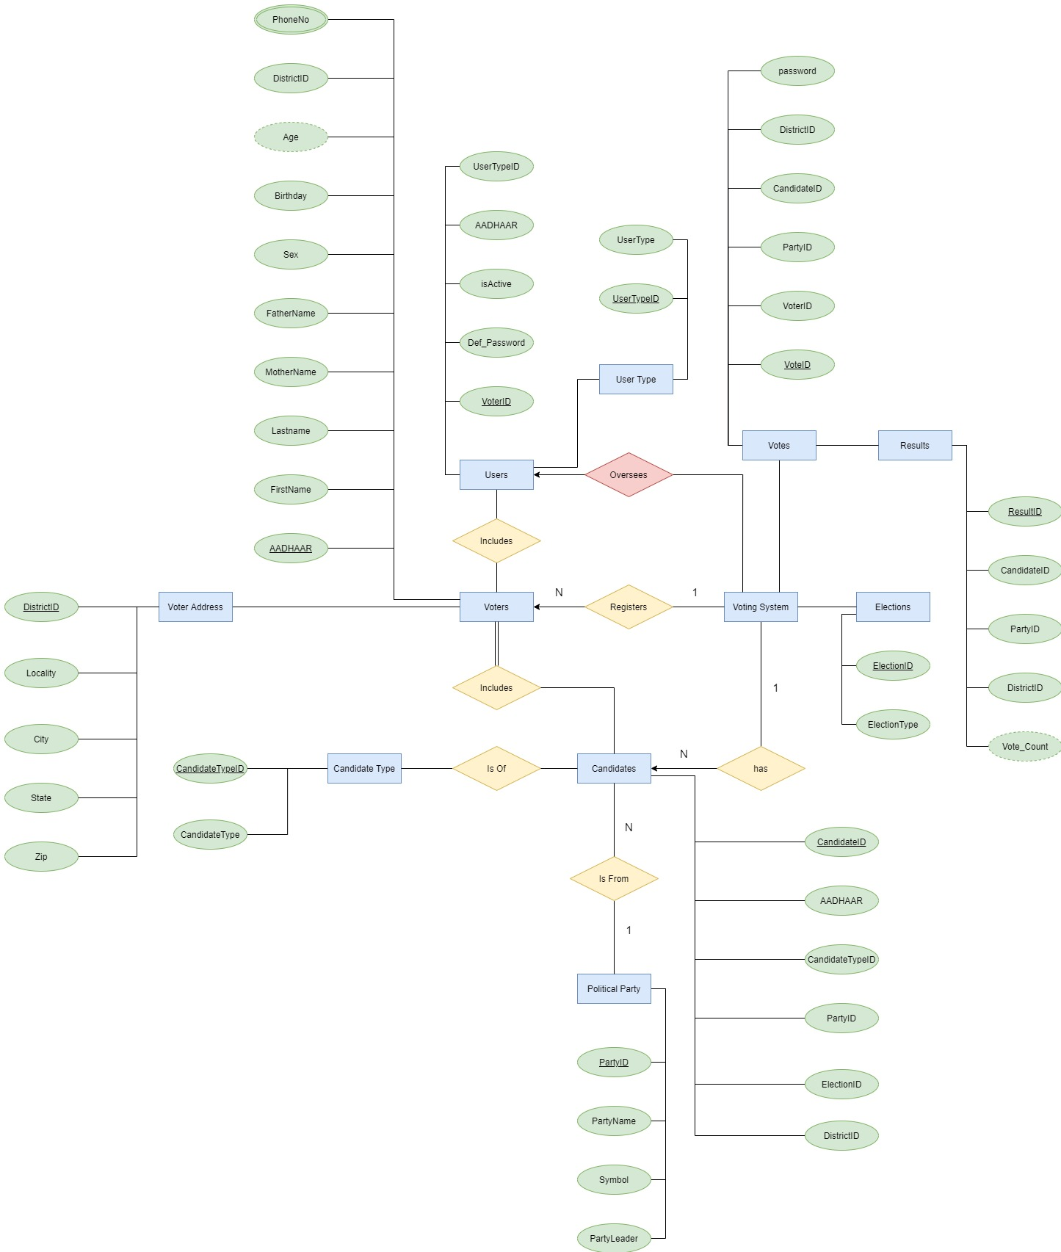
ERD MODEL

Slide 5
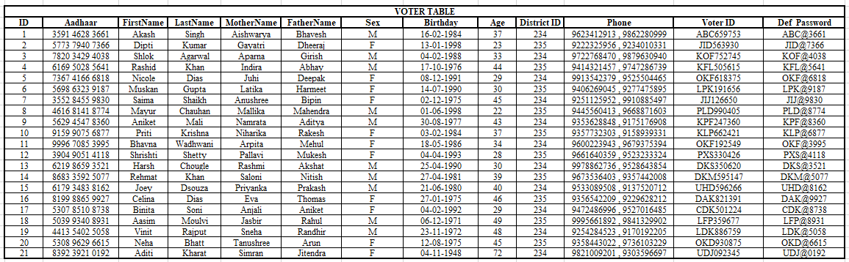
NORMAL FORMS

Slide 6
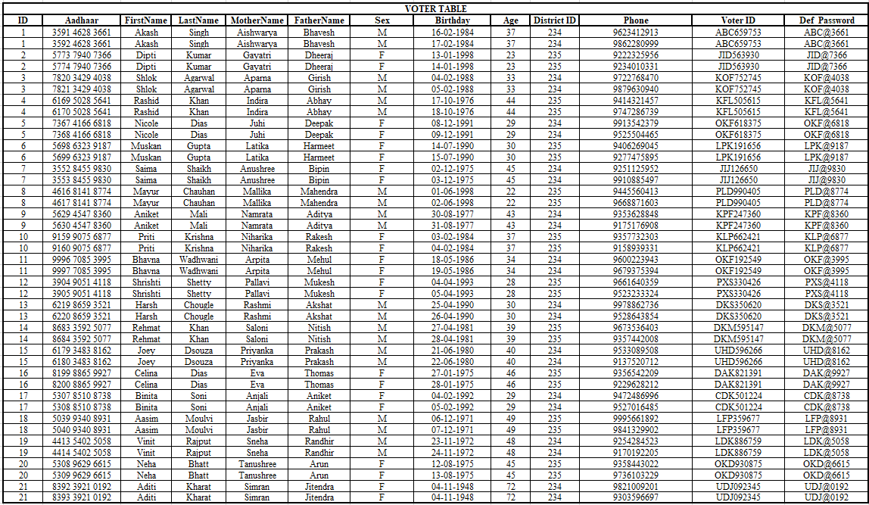
FIRST NORMAL FORM

Slide 7
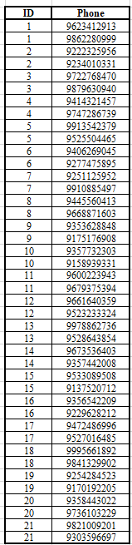
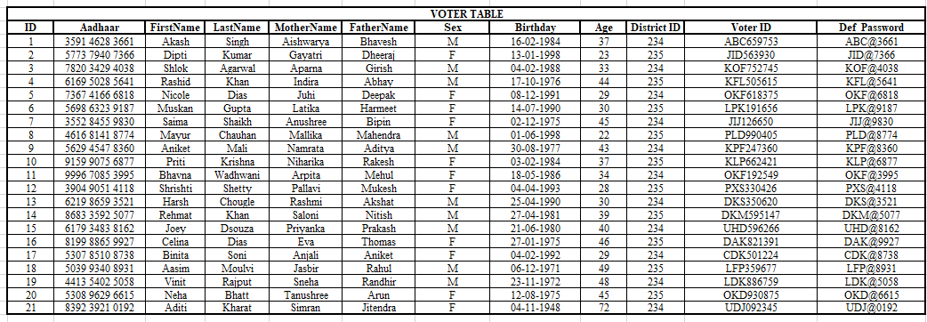
SECOND NORMAL FORM

Slide 8
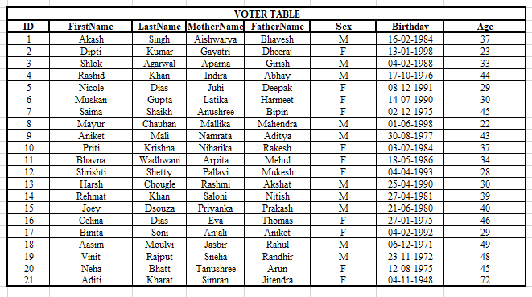
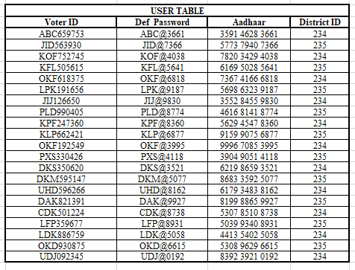
BOYCE-CODD NORMAL FORM

Slide 9
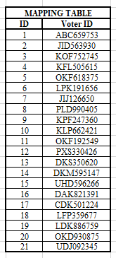
BOYCE-CODD NORMAL FORM

Slide 10
TABLES AND ITS DESCRIPTION

Slide 11

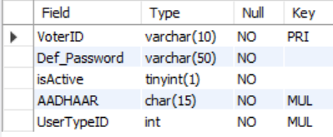
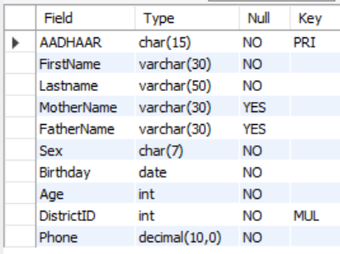
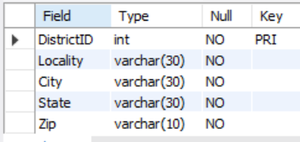
USER TYPE
USER TABLE
VOTER TABLE
ADDRESS

Slide 12
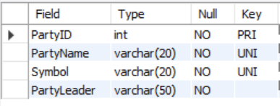

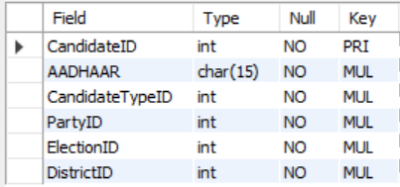
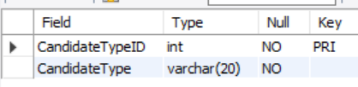
ELECTION TYPE
PARTY TABLE
CANDIDATE TYPE
CANDIDATE TABLE

Slide 13
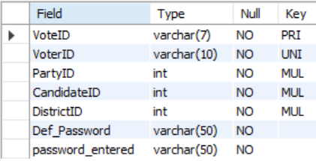
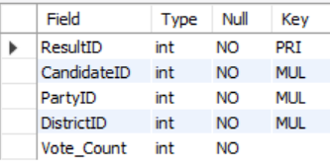
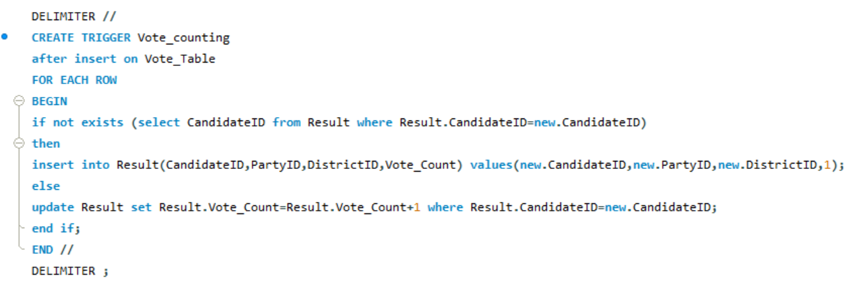
VOTE TABLE
RESULT TABLE
TRIGGER FOR RESULT TABLE

Slide 14
LET’S USE QUERIES TO ANSWER SOME BASIC Questions
1. What if a person changes there number permanently?
Ans: UPDATE IT!
2. What will you do if for some political reason voting needs to occur again and you have to delete all rows from the vote and result table?
Ans: TRUNCATE IT!
3. Do you want to know how many people from voted from a particular district?
Ans: COUNT IT!
4. Do you know how many a votes each party got from all the districts combined?
Ans: GROUP IT and ADD IT!
5. What will we do with a person’s information who dies?
Ans: DELETE IT!
6. Want all the details related to each candidate?
Ans: JOIN MULTIPLE TABLES!

